Slide 1

Data Analysis for Bayarea Real-estate prices
Venkata Sai Bala Krishna Batchu –im2250
Supraja Bakki
Rajasekhar Reddy
Sai Rohit Reddy Nagella
Chnadra tej kurella

Slide 2

Exploratory Data Analysis
After Data pre-processing we can forward with next step and then analyze data .
Analyzing and inferring Insights based on the Bayarea Real estate Data .
Considering Factors like Price per square feet, lotsize ,no.of bed rooms,no.of bathrooms
Price analysis with the Zestimate column.

Slide 3
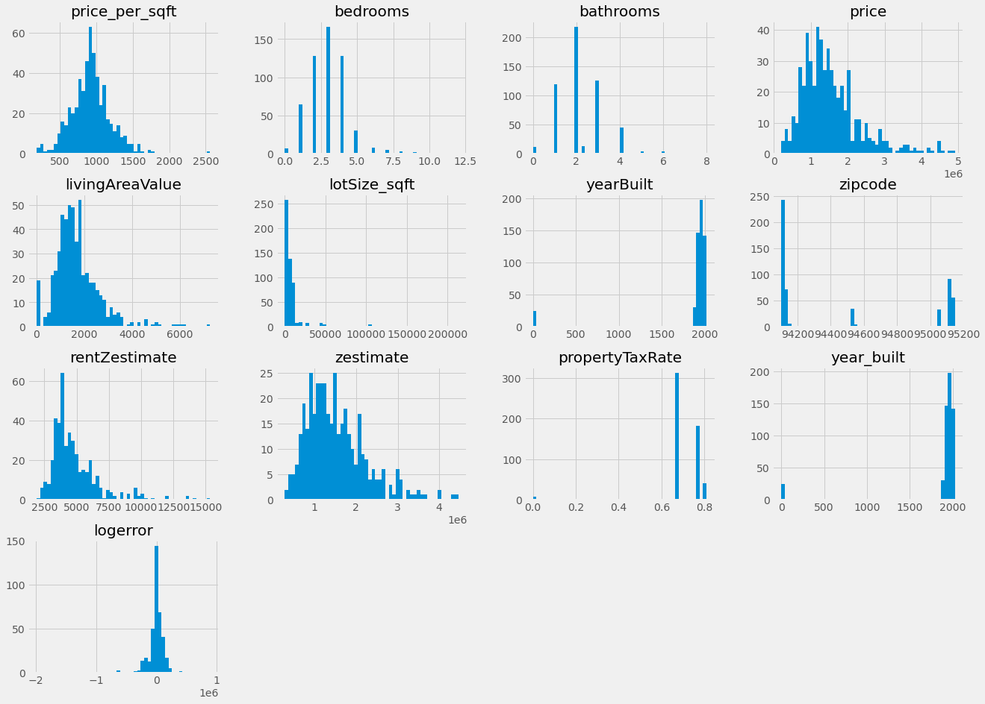
Histogram plots for various columns to get an overview of attributres
Histogram plots can be a summarize discrete or continuous data that are measured on an interval scale.
Price is left skewed initially after removing the extreme outliers with very high price values and then hist plot is following a distribution.

Slide 4
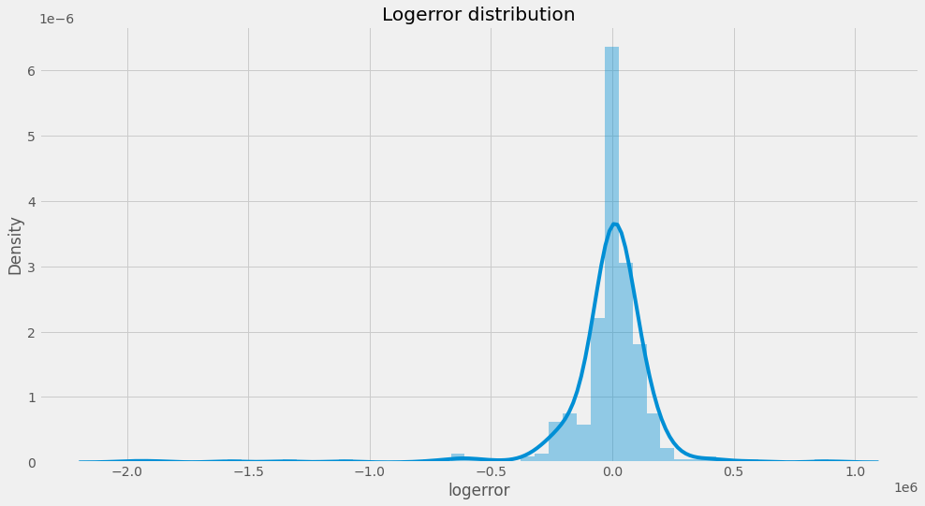
Logerror for price and zestimate
#zestimate and price differntiaition can be calculated using logerror
from the below graph about the logerror distribution we can observe the data we have negative and positive logerror.
a negative logerror means Zestimate is underestimated the house sale price, whereas positive logerror means overestimating.
logerror close to zero will definetly means that Zestimate is very close to sale price.

Slide 5
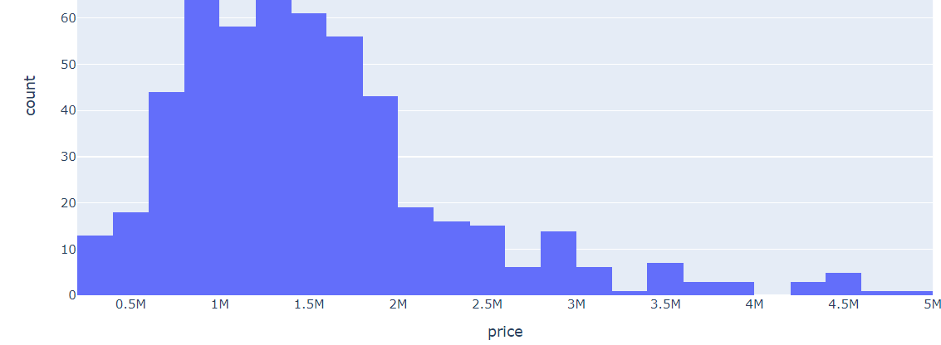
Price graph after outliers are removed from price column
once extreme high value outliers are removed we can see the difference from the data to distrubiuted around 1.25M price level on average in the Bayarea. .

Slide 6
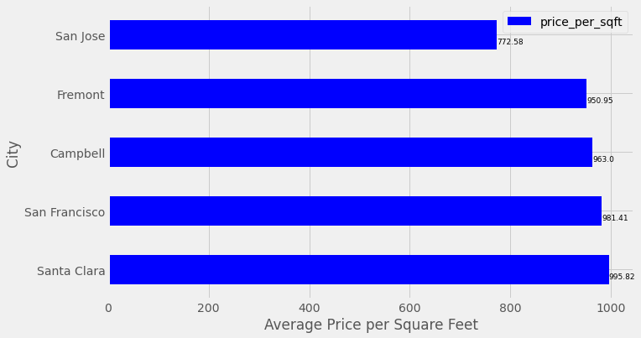
Top cities in Bayarea as per the Average price per square feet
We can observe form the attached picture and infer that SFO city, santaclara has the highest average price per square feet.
Whereas, San Jose is least average price per square feet.

Slide 7
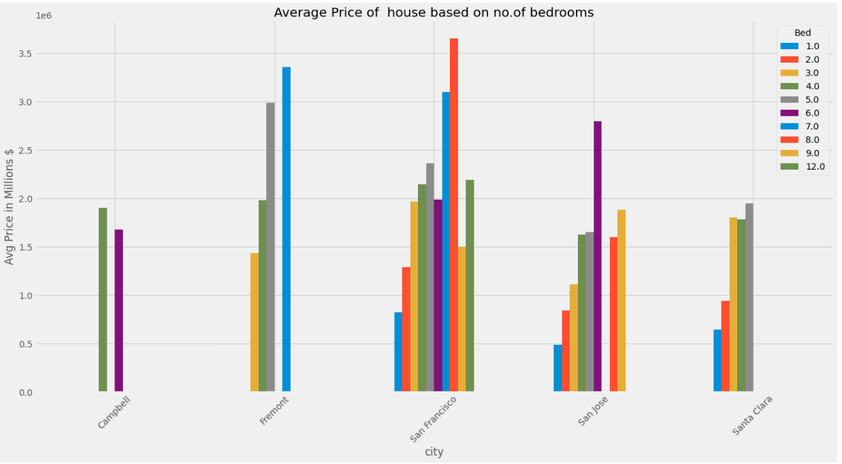
Average price of house based on bedrooms at different cities
Sfo, Fremont cities seems to be having high prices for the available no.of bedroom apartments as per our data analysis.
Santa Clara and campbell have comparatively lower prices and lower number of bedrooms.

Slide 8
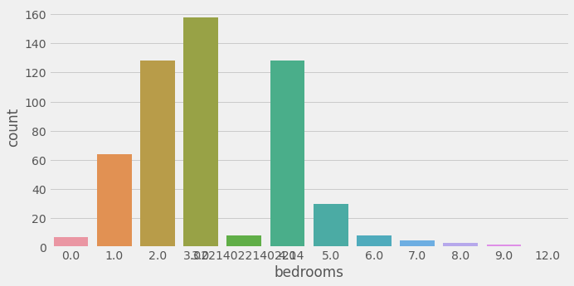
Total Properties as per no of beds
As per the data obtained there are 3 bedroom houses of larger count (close to 160) followed by 2 bedroom and 5 bedroom Houses around 130 count each.
And less than 5 count of houses with 9 bedrooms.

Slide 9
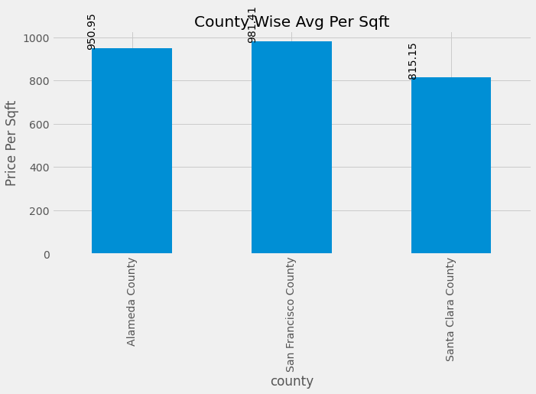
Bar plot of county and average price per sq ft
Sanfransico county seems to on top for the prices per sqft .

Slide 10
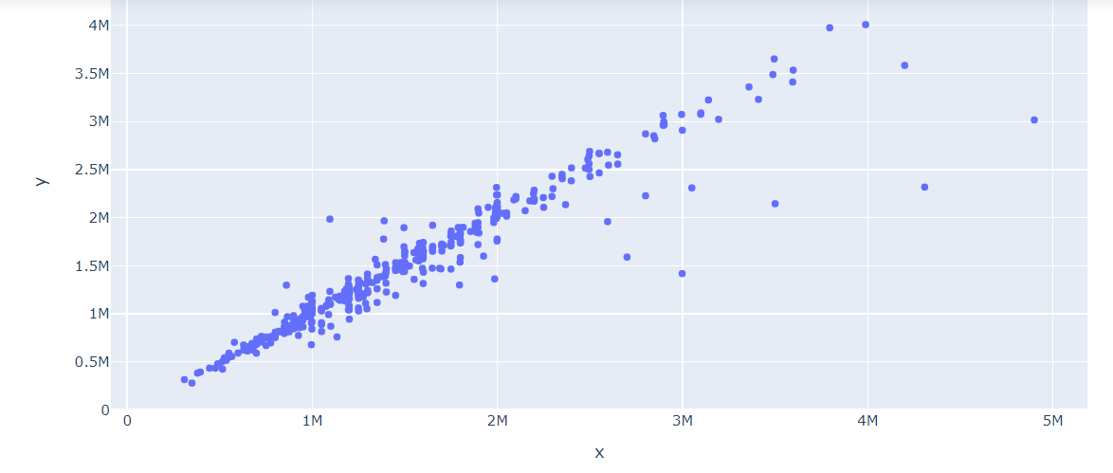
Scatter plot analysis between price and zestimate .linear with each other

Slide 11
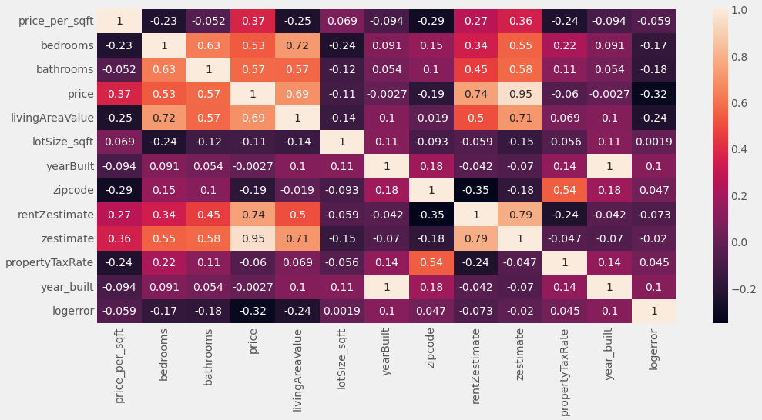
Correlation analysis
As per the data extracted and analyzed we can depict that the co-orelarion between price,zestime column is around 0.95
This can also be confirmed with the previous graph and the linear relationships with both the data as per the analysis.

Slide 12
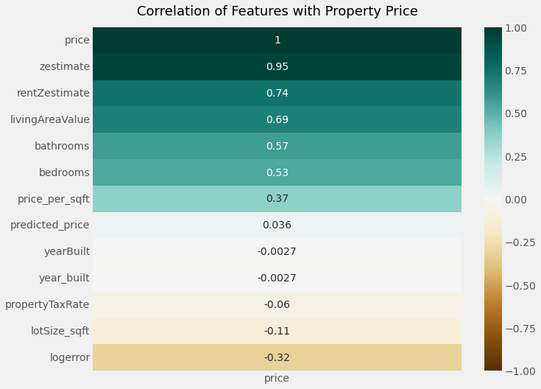
Corerelation of different columns with price column
Zestimate column price seems to be correlated with price with 0.95 value.

Slide 13
Prediction Analysis – Linear Regression
Extracting relevant independent variables (X) like - price_per_sqft','bedrooms','bathrooms','livingAreaValue', 'lotSize_sqft’ …..
Price would be our dependent or target variable (Y)
Splitting data into test and train data using sklearn library
Creating and fitting the linear regression model with testing data size 30%
Comparing actual vs predicted values and calculating mean absolute error, mean squared error, root mean squared error, to make inferneces

Slide 14

R2 score of the model 0.807606..
R² is a measure of the goodness of fit of a model. In regression, the R² coefficient of determination is a statistical measure of how well the regression predictions approximate the real data. points. An R² of 1 indicates that the regression predictions perfectly fit the data.
So as the regression model 0.8 is the R^2 value and our model seems to have an accuracy of 80% in predicting the prices.

Slide 15
Metrics for
Accuracy score training data – 78.53%
Accuracy Score for testing data- 86.5%
Regression statistics
Mean Error (ME) : 16089.1434 ($)
Root Mean Squared Error (RMSE) : 281637.9003 ($)
Mean Absolute Error (MAE) : 185177.8514($)
Mean Percentage Error (MPE) : -0.2518%
Mean Absolute Percentage Error (MAPE) : 15.0868%

Slide 16

Analysis of different business and price aspects based on our data analysis with price, property tax, price per square feet, Price as per no.of rooms Lot Area

Slide 17
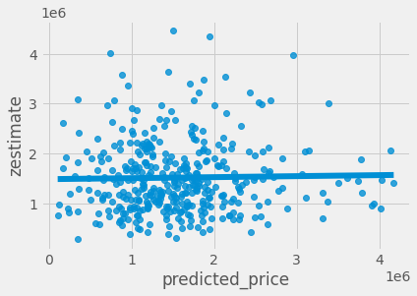
Scatter plot between predicted price,zestimate

Slide 18
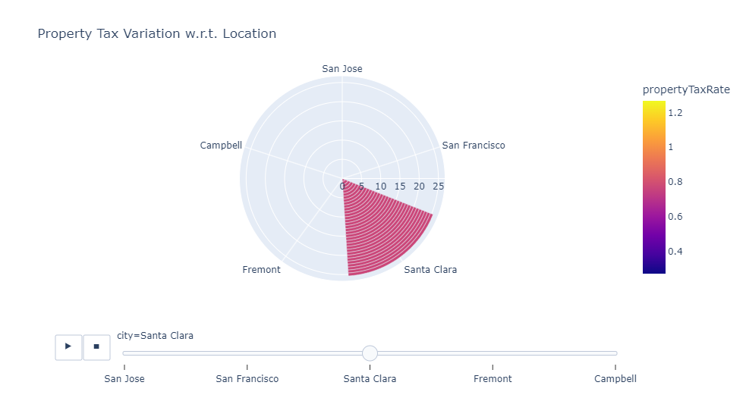
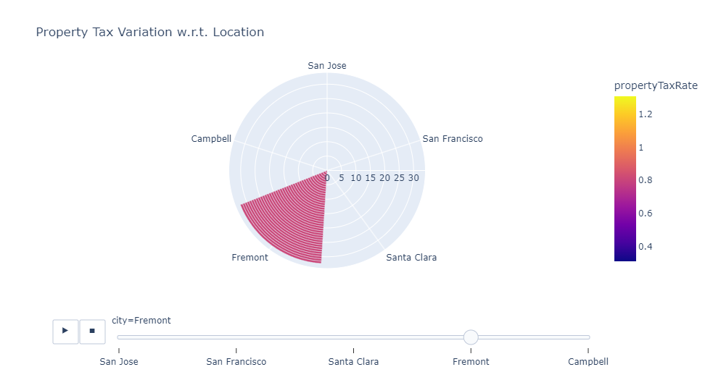
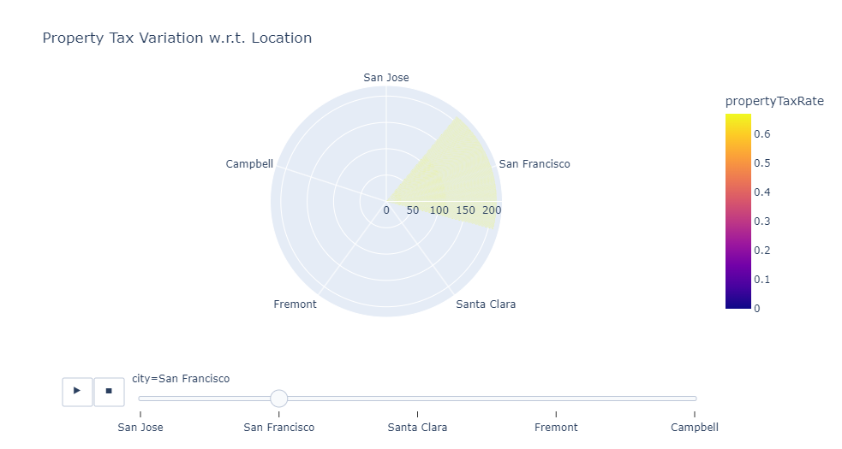
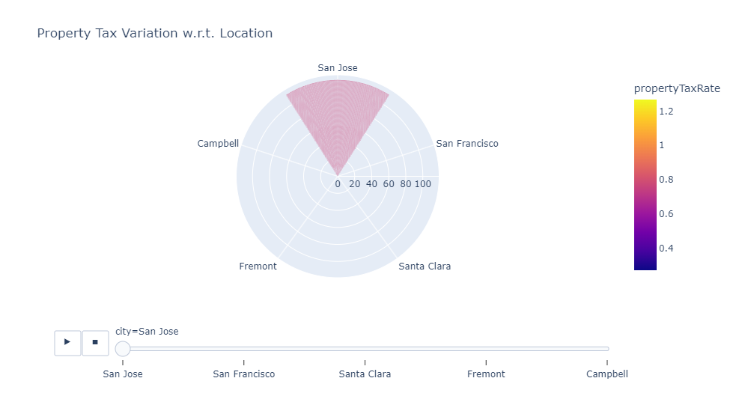
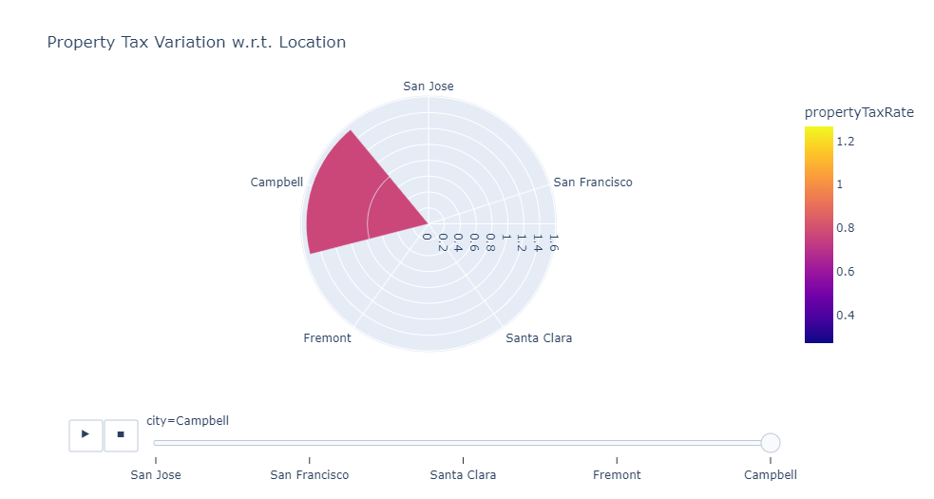
Property tax analysis as per location
Sfo-0.67
Sanjose-0.77
Santaclara-0.77
Campbell-0.77
Fremont-0.81

Slide 19
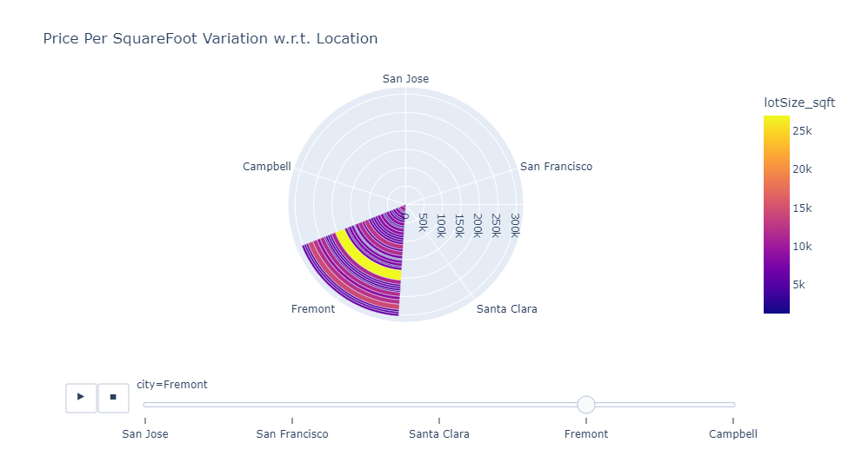
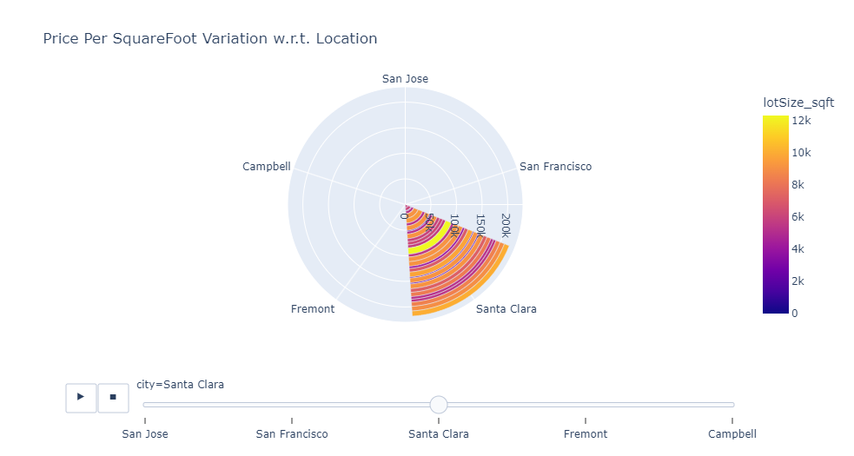
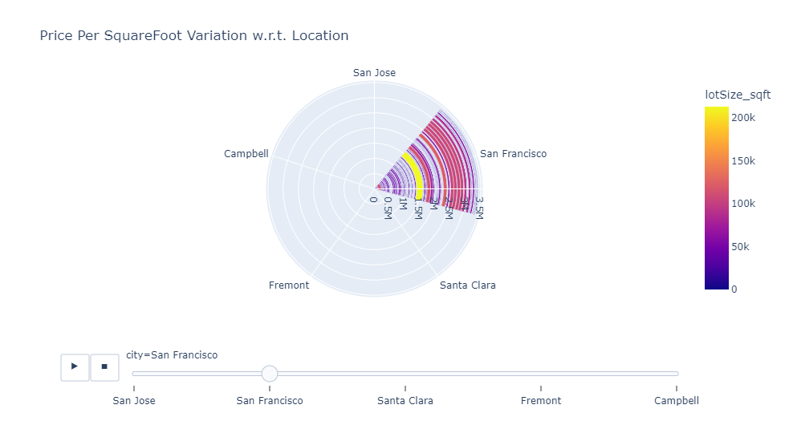
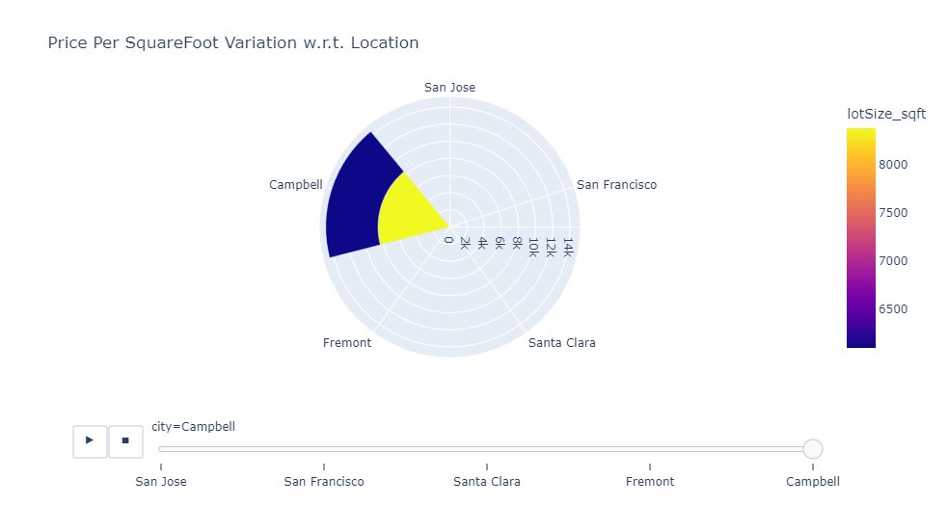
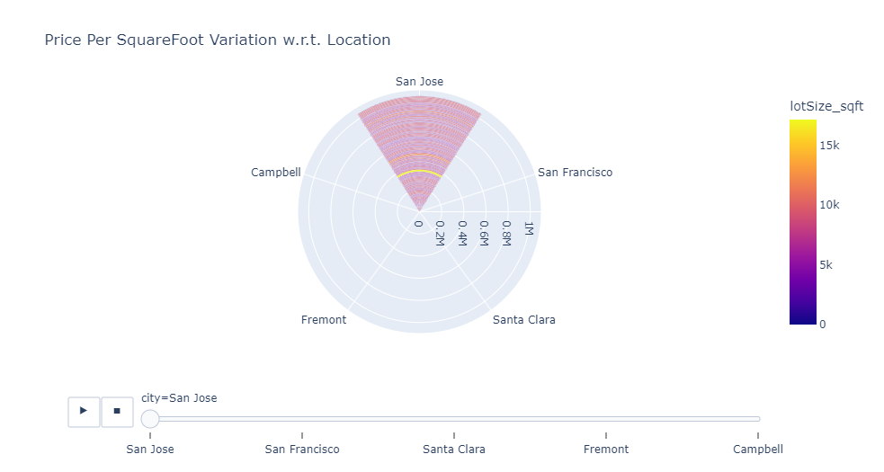
Pie plot of price per square foot with respect to location

Slide 20
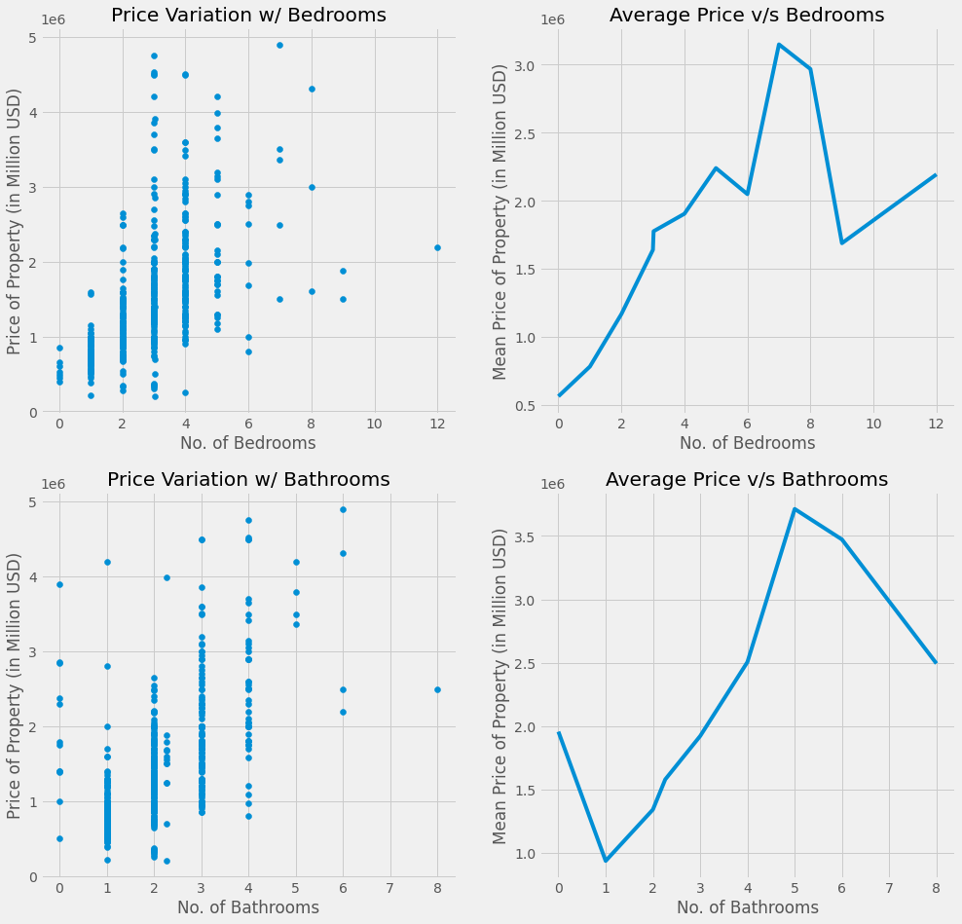
Prediction Analysis
Price is increasing linearly with number of bedrooms until 8 once after that price seems to be decreasing steadily until 10 bed rooms which might be with limited demand.
Also, price on average increasing steadily from 1 bathroom to 5 bath rooms and then continues to decrease steadily.

Slide 21
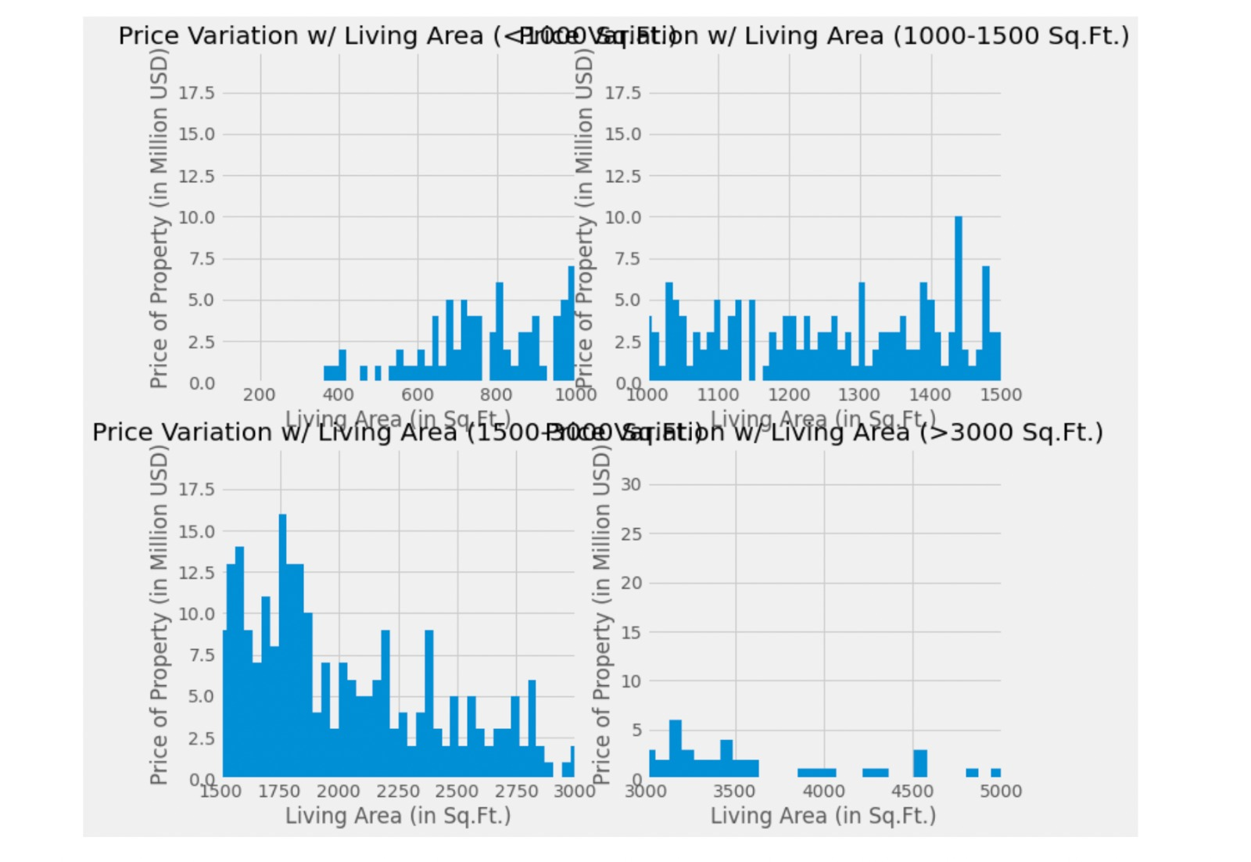
Variation of price with respect to living area
Prices of homes in bayarea seems to be highest with the homes having lot area size of 1500-3000 sqft.
Lowest prices are with above 3000 sqft.

Slide 22
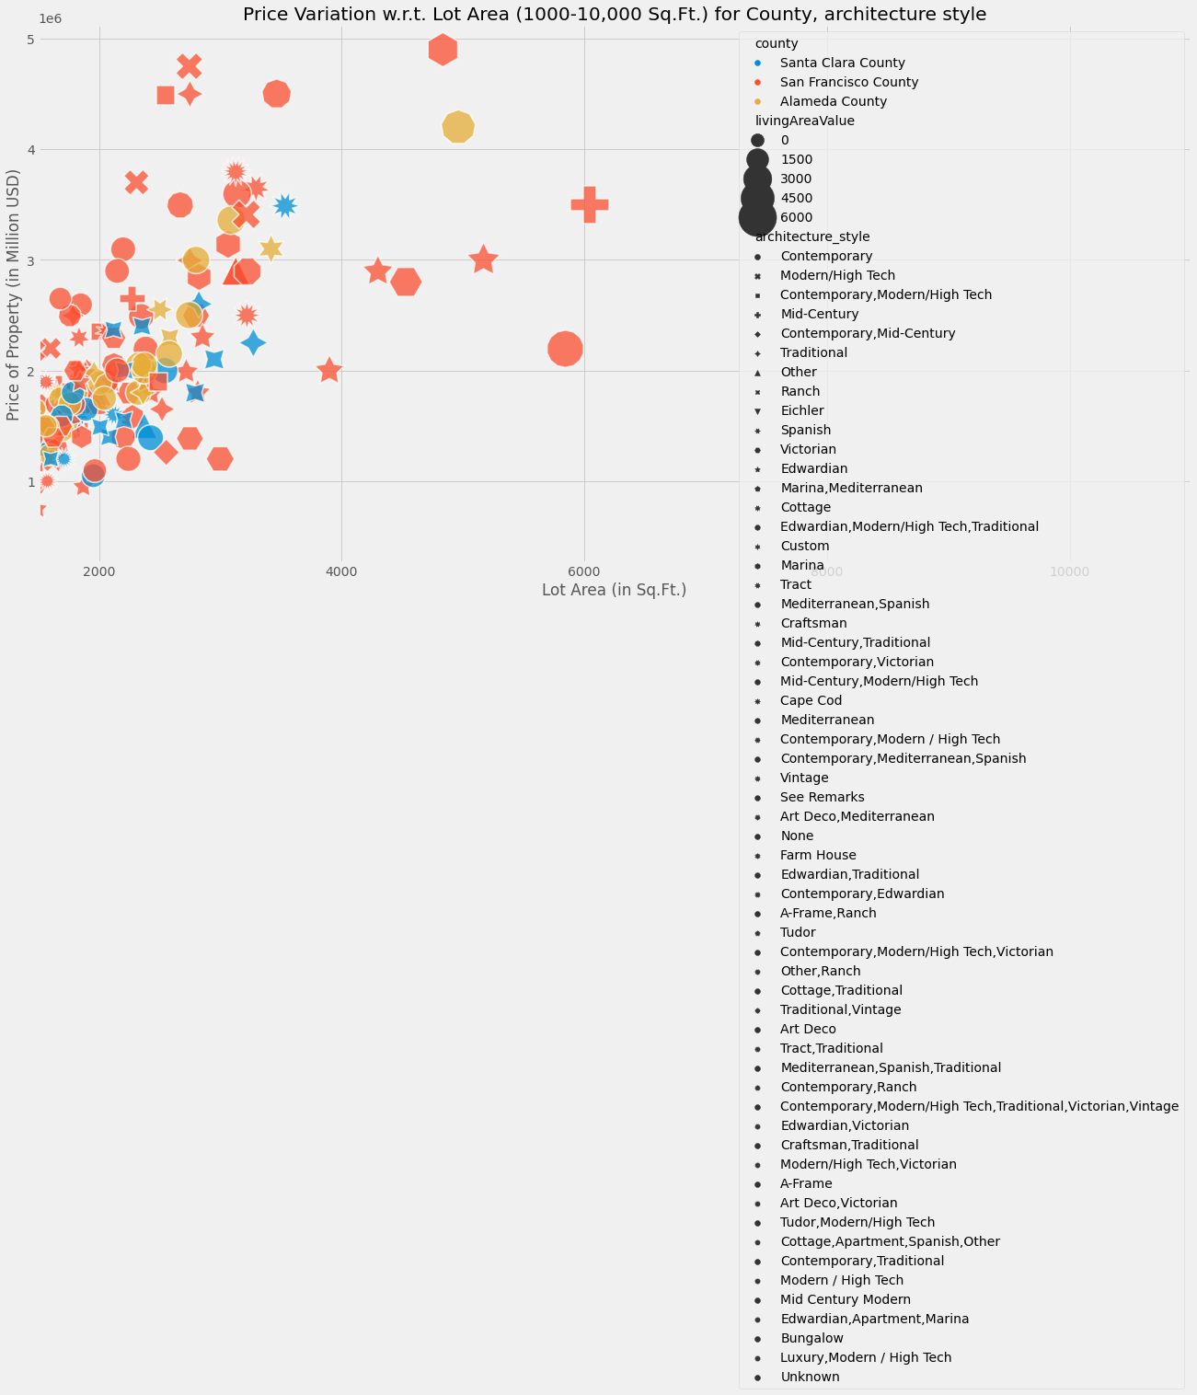
Architecture style of houses in bayarea
Most of the houses in bayarea people are choosing for Contemporary style
With average home size in sqft is in between 2000 to 4000 sqft

Slide 23
Prediction Analysis - Inference
Average living prices in cambell and almeda county seems to be low on average with around 1million and sanfransico and santa clara housing prices seems be to over 2million on an an average.

